Slide 1

Experience Expo Analysis 8 Weeks Experiential Learning Program
Dates: June 27th - August 22nd Location: Seattle Campus
Notes:
1

Slide 2



Program Overview
Purpose:
Unite graduate students across the Seattle campus.
Facilitate interdisciplinary projects under the guidance
of industry mentors and faculty advisors
Duration:
The program spans a duration of 8 weeks
Structure:
Weekly professional seminars
Project work

Slide 3



Program Components
Interdisciplinary Team:
Students from various colleges, including the College of Professional Studies, Khoury College, College of Engineering
Project Setup:
8 projects with 5 students per team
Each team comprises students from diverse backgrounds
Total Participants:
40 Graduate students 7 Students from COE 9 Students from CPS 16 students from Khoury college

Slide 4
Workshop Analysis
The workshops received highly positive feedback, with most participants rating them 4 out of 5, demonstrating their usefulness and impact
A total of 5 workshops were conducted, covering essential topics:
Collaboration Skills and Team Communication
Presentation Skills, Team Presentations and Leadership Skills
Students expressed strong interest in additional workshops, particularly those offering practical, hands-on learning opportunities
Overall, 84% of students reported that the workshops were effective

Slide 5
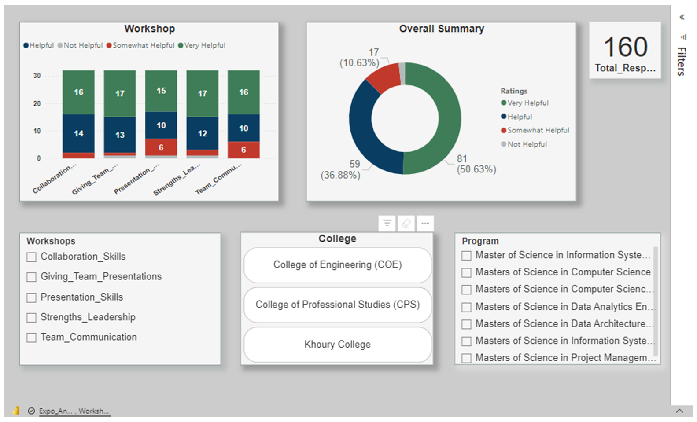
https://app.powerbi.com/links/nUBR5j62-7?ctid=a8eec281-aaa3-4dae-ac9b-9a398b9215e7&pbi_source=linkShare&bookmarkGuid=f8dac42b-98db-41a7-93c2-f1691c09832a
Notes:
5

Slide 6
Skills Analysis
The Skills Application analysis highlights the variety of skills students utilized, including:
Technical skills
Presentation skills
Collaboration skills
Real World Application skills
Team Communication
88% of students agreed they effectively applied these skills during the expo
Collaboration skills received the highest number of positive responses
Technical skills received the lowest number of positive responses

Slide 7
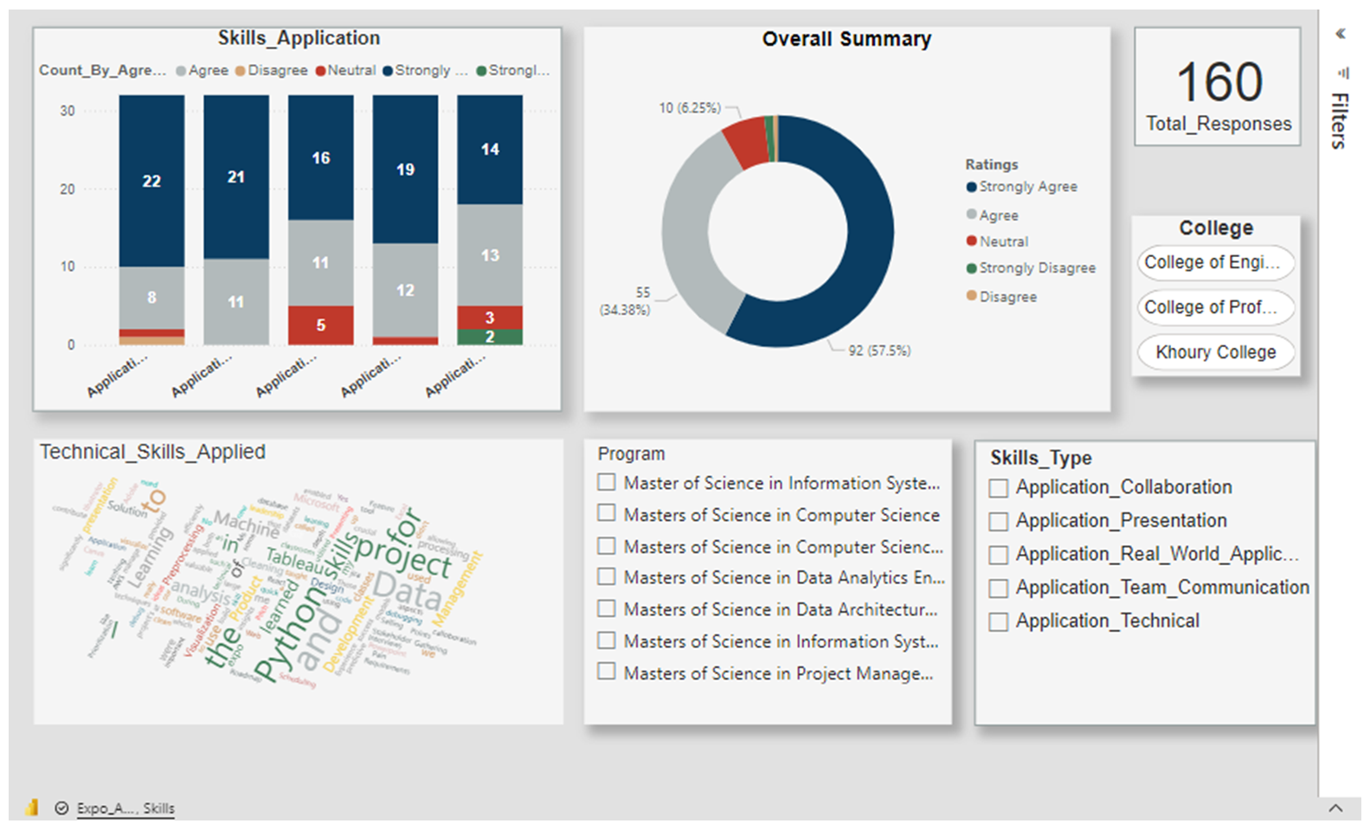
https://app.powerbi.com/links/nUBR5j62-7?ctid=a8eec281-aaa3-4dae-ac9b-9a398b9215e7&pbi_source=linkShare&bookmarkGuid=0a33a0ac-f223-4a84-a4a4-9026d9cd3b3b

Slide 8
Support Analysis
The Support Buckets analysis evaluates the effectiveness of assistance provided by Industry Mentors, Learning Coaches, and Faculty Advisors
82% of students rated the support from Learning Coaches and Industry Mentors as helpful and effective
Among the support types:
Learning Coaches received the highest rating at 96%
Industry Mentors followed with an 85% rating for their effectiveness
Faculty Advisor 48% rating for their support and helpfulness

Slide 9
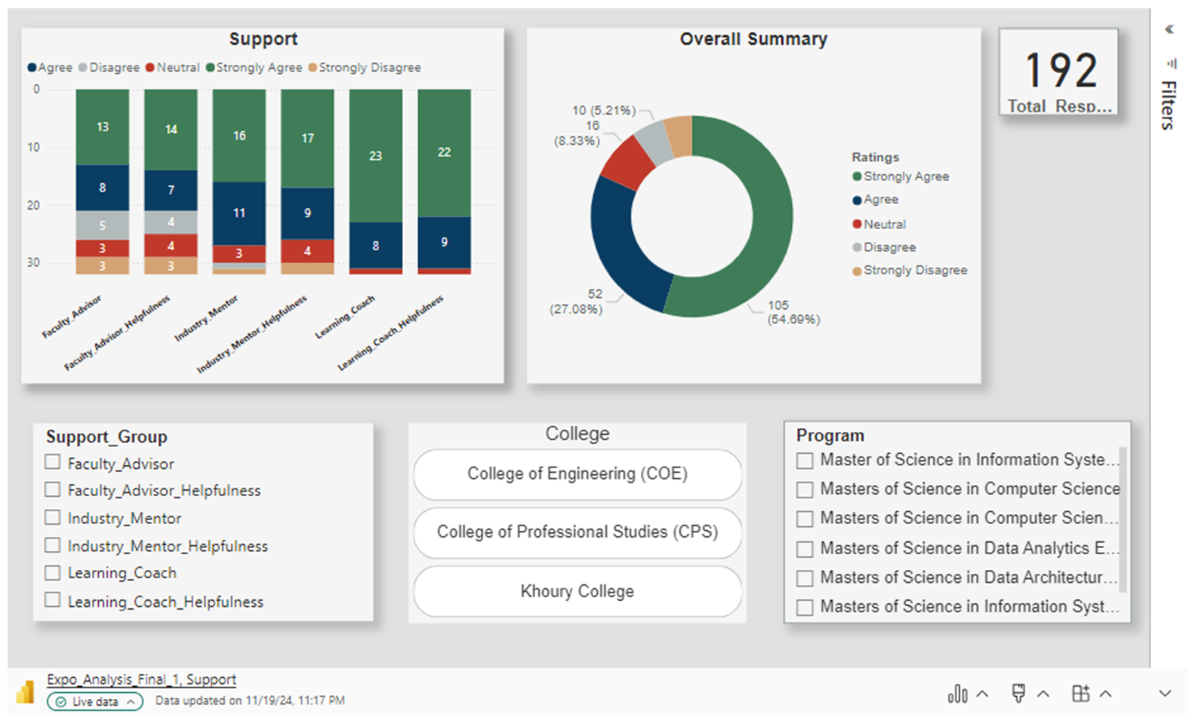
https://app.powerbi.com/links/nUBR5j62-7?ctid=a8eec281-aaa3-4dae-ac9b-9a398b9215e7&pbi_source=linkShare&bookmarkGuid=f4079ac0-b7d4-4732-8d1c-8efbac23bfab
Notes:
9

Slide 10
Confidence Development Analysis
Key Areas of Development: The analysis reveals significant growth in students' confidence across essential areas, including Leadership, Networking, Collaboration, Articulating Strengths, Problem Solving, Public Speaking, and Technical
Strong Agreement: An impressive 86% of students strongly agreed that the expo effectively boosted their confidence in various skill sets
Top-Performing Colleges: Among the colleges, CPS and Khoury College stood out with the highest confidence ratings, achieving 86% and 75%, respectively

Slide 11
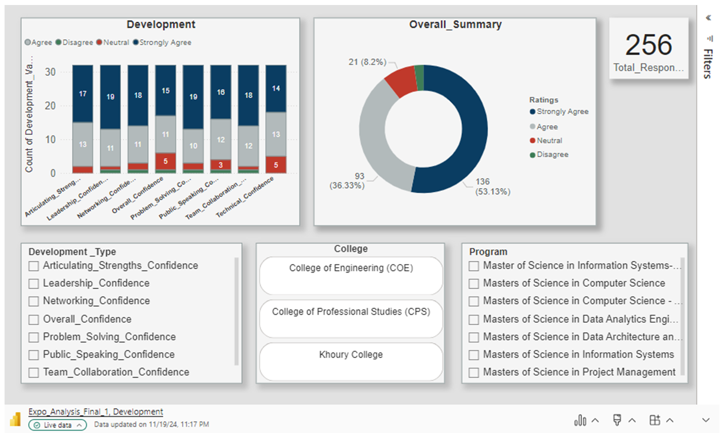
https://app.powerbi.com/links/nUBR5j62-7?ctid=a8eec281-aaa3-4dae-ac9b-9a398b9215e7&pbi_source=linkShare&bookmarkGuid=aacbb8c6-f734-4fce-a814-3a2e479e18be

Slide 12
Learning Coach Feedback Analysis
High Satisfaction: Most coaches rated the experience 5 stars, highlighting strong satisfaction
Professional Growth: Coaches valued the opportunity for development and fulfillment
Key Challenges: Common issues included communication gaps and unclear project scopes
Positive Feedback: Testimonials praised the experience and expressed eagerness to return
Improvements Suggested: Enhance pre-event prep, regular check-ins, and offer partner support or training resources

Slide 13
Highlights
Exceptional Overall Satisfaction
Enhanced Skill Development and Practical Application
Strong Mentorship and Dedicated Support
Valuable Networking Opportunities
Enriching and Positive Learning Experience

Slide 14
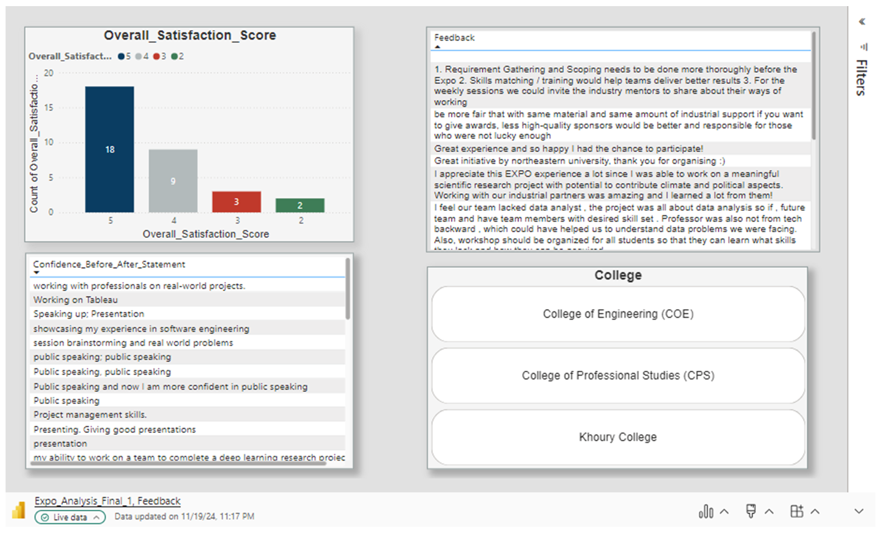
https://app.powerbi.com/links/nUBR5j62-7?ctid=a8eec281-aaa3-4dae-ac9b-9a398b9215e7&pbi_source=linkShare

Slide 15
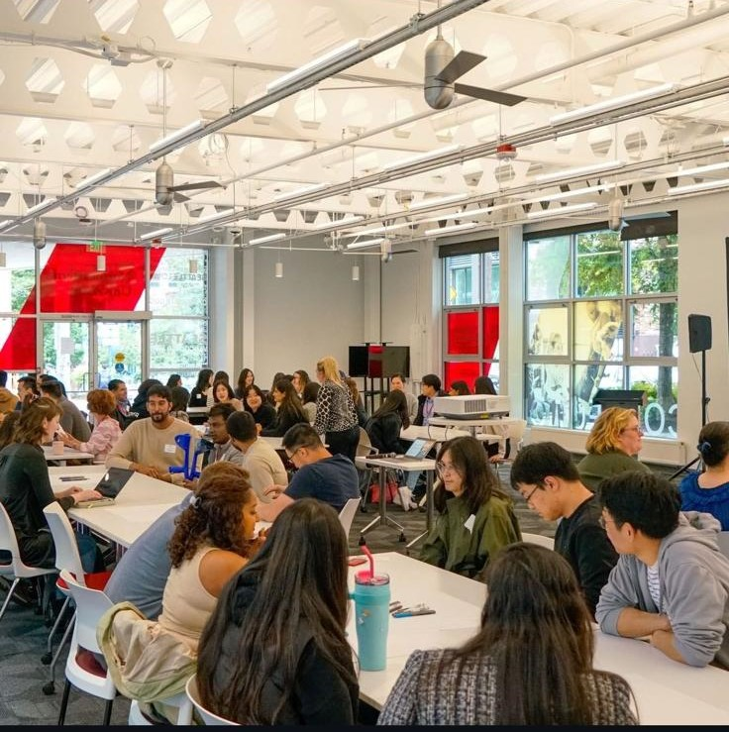
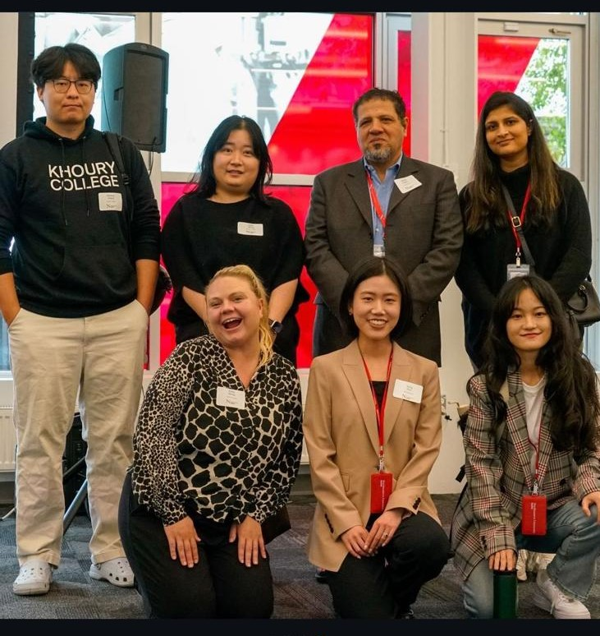
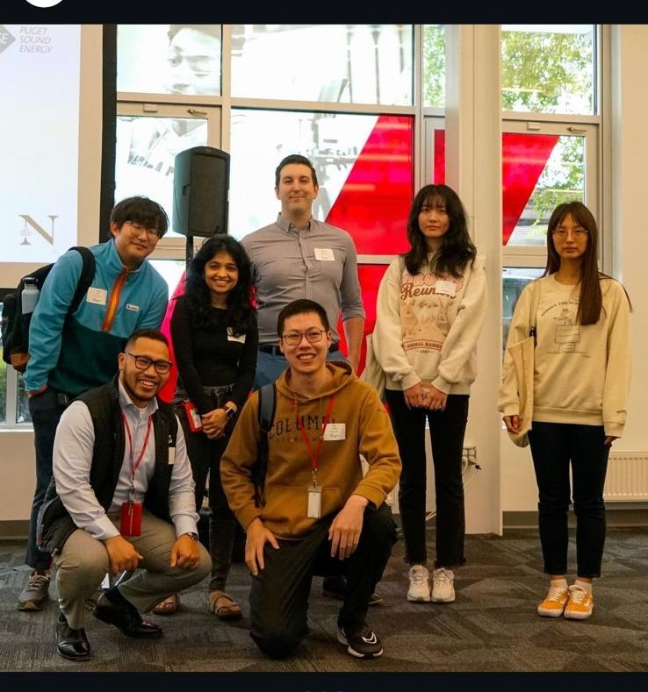
"Serving as a Project Manager for the Expo provided me with invaluable practical experience,
offering a real-world application of project management principles."
"Great experience and so happy I had the chance to participate!"
"This was an excellent opportunity to showcase our skills and
collaborate with industry experts.
It was both beneficial and enjoyable."
"I appreciate this EXPO experience a lot since I was able to work
on a meaningful scientific research project with potential to contribute climate and political aspects.
Working with our industrial partners was amazing and I learned a lot from them!"

Slide 16
Recommendation
Enhance Hands-on Workshops.
Increase Early preparation opportunities
Improve Mentor Engagement
Targeted support for Low satisfaction Colleges
Clearing Project Scope from the beginning
Extending Project Durations

Slide 17
Thank You
We Appreciate Your Time and Attention
Notes:
17

